Slide 1
Business Cycles:
Business cycle refers to the wave like fluctuation in the economic activities such as output, income and employment.
In other words, it refers to the tendency of the business activity to fluctuate between prosperity and depression. It is a upward and downward movement of the economic activity.
According to J. M. Keynes, “ A trade cycle is composed of periods of good trade, characterised by rising prices and low unemployment percentages alternating with periods of bad trade characterised by falling prices and high unemployment percentages”.
According to Haberler, “ the business cycle is a situation in which the alternation of periods of prosperity and depression of good and bad trade”.

Slide 2
Features of Business Cycle:
1. It occurs periodically.
2. It is comprehensive.
3. It is a wave like movement.
4. It is a cumulative process.
5. The trade cycles will be similar but not identical.
6. The upward swing is slow and gradual.
7. Its effect is more visible in capital goods industries.
8. It is parallel with monetary demand and production.

Slide 3
Phases of Business Cycles:
An identified business cycle is characterised by different phases. They are,
1. Depression or Deflation
2. Recovery or Revival
3. Boom or prosperity or Inflation
4. Recession.

Slide 4
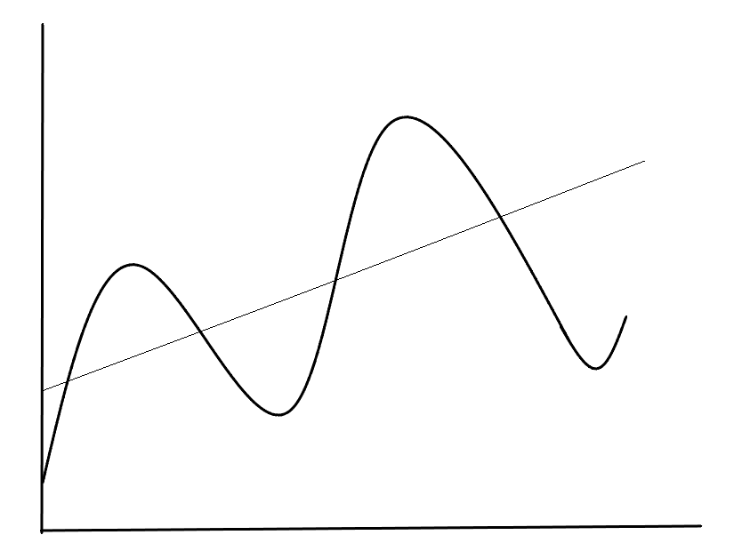
y
Peak/Boom
Recession
E
Prosperity
Level of Economic activity
Peak/Boom
Prosperity
Recession
Depression
Recovery
Depression
Recovery
Trough
Trough
Recovery
o
x
Time

Slide 5
1. Depression:
It is a situation of severely falling prices and the lowest level of economic activates. The features of depression are just the reverse of the prosperity. Natural and human resources are unexploited.
The national output, employment, income and price level, profits, wages are falling. The absence of effective demand for goods and services are the features of the economy. It is also characterised by deflation.
The working class suffer heavily because of low wages and unemployment.
2. Recovery or Revival:
The turning point from depression to expansion is called as recovery or revival
National income, production, employment and utilization of productive resources slowly & steadily begin to raise. The price start raising, wages, interest and returns start raising. Optimism in all business activities. Autonomous investment stimulate the economic activity.

Slide 6
3.Boom or Prosperity :
The full employment and movement of the economy beyond full is characterised as boom period. It leads to an increase in wages, interest and profit. It is a peculiar situation of over full employment.
There is general feeling of optimism among the businessmen and industrialists. Demand for factors of production increases. The important features of upswing in boom periods are
Raising prices.
Large volume of production.
High level of employment.
Rising interest rates.
Inflation.
Large expansion of credit.
Overall business optimism.

Slide 7
Recession:
The turning point from prosperity to depression is called as recession phase. During recession, all economic activities starts falling.
Investors are drastically reduce investment, production comes down, income and profits decline. There is panic in the stock market and business activities.
Causes of Trade Cycles:
Internal Causes of Trade Cycles:
Internal causes of business cycles are those which are built in within the economic system. They are,
Psychological Factors:
According to Pigou business cycle appears because of the optimistic and pessimistic mood of the entrepreneur.
Money Supply:
According to Hawtrey and Friendman, cyclical fluctuations are caused by expansion and contraction of money and bank credit.

Slide 8
3. Over Investment:
According to some economists, fluctuations in investments are the prime cause of business cycles. Excessive investment in capital goods industries brings upswing and downswing when there is a fall in investment.
4. Marginal efficiency of capital:
According to Keynes, changes in the rate of the marginal efficiency of capital are responsible for business cycle.
5. Under Consumption:
According to Hobson and Foster, business cycles are caused by under consumption or over saving.
6. Technological Innovations:
According to Schumpeter, innovations in the structure of an economy are the source of economic fluctuations.
7.Competition:
According to Chapman, the main cause of business cycle is the existence of competition in an economy which leads to over production and ultimately to a crisis.

Slide 9
External Causes of Trade Cycles:
Wars.
In war days all the available resources are utilized for the production weapons which greatly affect the product of both capital and consumer goods this fall in production decreases income , profits which further create unemployment . These create a contraction in economic activity .
2. Postwar Period
in the post –war period , the level of consumption and investment goes upward. Both the government and individuals involve the construction [ houses, roads ,bridges etc ] . All these activities increase the effects due to which the economic variables ,output ,income and employment goes upward .
3. Scientific Development
Another cause of the business cycle is scientific development. Every day new products come to the markets like mobile phone ,laptops etc . These products require huge amount of investment through which new technology of production is adopted . All this increases income , employment and profit etc .

Slide 10
4.Gold Discoveries
The discoveries of gold and mines stimulate the volume of international trade and help in adjusting trade deficit , loans etc .the rising income leads to an expansion in economic activity.
5.Surplus Exports and Foreign aid
Surplus exports and foreign aid raises the level of consumption and investment spending which helps in increasing output , income and employment level .
6.Weather
Weather is one of the causes of the business cycle . It is an important factor which can cause economic activities . If in any year , weather is good the output of the agricultural sector will go upward .
7.Population Growth Rate
The population growth rate is one of the factors of the business cycle . If the population growth rate is higher then the economic growth rate , income level and consumption expenditure and savings will be low .

